Slide 1
Experiential Learning Phase -II :
Operating Systems
Operating System Modules
Talasila Dheeraj
1RV22CS216
Srivatsa N
1RV22CS204

Slide 2
PRESENTATION CONTENTS
Problem Statement:
Design and develop various OS modules to create a comprehensive and efficient operating system.
Relevance:
The kernel is the heart of the operating system, responsible for managing hardware resources and providing essential services to applications.
The file system module enables storage and retrieval of data on storage devices.
Tools/API’s:
Ubuntu(GCC), GNU assembler, Xorriso, Grub-mkrescue and QEMU.

Slide 3
METHODOLOGY
Kernel Development
File Management
Memory Management
Developing a kernel that performs various arithmetic and string operations.
Creating a file manager that could modify, create, delete, view and list directory.
Creating a Memory manager that takes input of block sizes and size of processes and displays the Best Fit, First Fit and Worst Fit

Slide 4
Kernel Development :
The kernel was built primarily using 6 files they are:
1.boot.s
2.linker.ld
3.grub.cfg
4.kernel.h
5.kernel.c
6.run.sh

Slide 5
1.1 Boot.s :
Setting Flags, Magic Number, and Checksum:
FLAGS are typically used to specify various options or features required by the bootloader or kernel.
MAGIC is a constant required by the Multiboot specification. It helps the bootloader identify the bootloader information structure.
CHECKSUM is calculated as a negation of the sum of MAGIC and FLAGS. This value ensures that the bootloader information structure is recognized correctly.
Multiboot Header Section:
This section defines the Multiboot header required by Multiboot-compliant bootloaders. It includes the MAGIC, FLAGS, and CHECKSUM values.
Stack Initialization:
Define the bottom and top of the stack, respectively and reserve 512 bytes of space for the stack.
Text Section:
Marks the beginning of the code section.
Start Routine:
Calls KERNEL_MAIN which is the main entry point of the kernel and runs an infinite loop.

Slide 6
1.2 Linker.ld :
It is used by the linker (such as GNU ld) to map input sections from object files to the final executable.
It begins by specifying the entry point of the program as _start. The script then defines several output sections:
.text: This section contains executable code. It's aligned and organized into 4KB blocks, with content from input files such as .multiboot and .text sections.
.rodata: This section contains read-only data, like constant strings or other immutable values. Similar to .text, it's aligned and organized into 4KB blocks.
.data: This section contains initialized data, such as global or static variables with explicit initial values. It's also aligned and organized into 4KB blocks.
.bss: This section contains uninitialized data, like global or static variables without explicit initial values. It's aligned and organized into 4KB blocks as well. This section includes both common symbols (variables shared among multiple files) and any remaining .bss sections from input files.

Slide 7
1.3 Grub.cfg :
1.4 Kernel.h :
menuentry "os" {
multiboot /boot/MyOS.bin
}
It is a configuration file defines a menu entry for MyOS.bin as os.
It initializes an array DIGIT_ASCII_CODES with ASCII codes for digits 0 to 9.
It declares a variable VGA_INDEX to track the current index in VGA memory.
It defines an enumeration vga_color for various VGA colors.

Slide 8
1.5 Kernel.c :
The code includes essential functions initialize the terminal, clear the buffer and print characters and strings. Additionally, it contains logic for arithmetic operations like addition, subtraction, multiplication, division, and modulus, as well as string operations such as concatenation and length calculation.
The `KERNEL_MAIN` function serves as the entry point, initializing the terminal, displaying an entry page, and executing arithmetic and string manipulation operations.

Slide 9
1.6 Run.sh :
1. Assemble the bootloader.
2. Compile the kernel source code.
3. Link the object files to create the kernel binary.
4. Create directory structure for ISO.
5. Copy kernel binary and GRUB configuration file to ISO directory.
6. Create bootable ISO image.
7. Run ISO image in QEMU virtual machine.

Slide 10
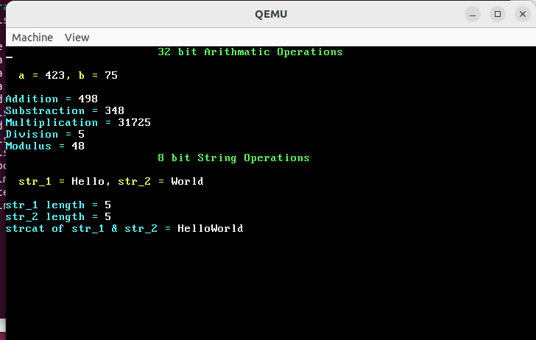
Output:

Slide 11
2. File Management :
File Management was implemented using 3 files they are:
1.library.h
2.library.c
3.main.c

Slide 12
2.1 library.h :
Header Files:
stdio.h
string.h
stdlib.h
dirent.h
Macros:
PATH “./Files/”
Function Declarations:
create file
delete file
modify file
view file
list directory

Slide 13
2.2 library.c :
This C file contains the definitions of the various functions used by our File Management System.
It contains the following functions:
Create New File:
This function is used to create a new file while covering all the required edge cases.
Delete File:
This function is used to remove an existing file. If incase, it doesn’t exist, it pops an error message.
Modify File:
This function is used to alter the contents of the existing file.
View File:
This function is used to view the file in read only mode.
List Directory:
This function is used to list the contents of the Directory.

Slide 14
2.3 main.c :
This file is used to display the menu using which the other files are accessed by the user.
Create a new file
Modify an existing file
Delete a file
View contents of a file
See directory listing

Slide 15
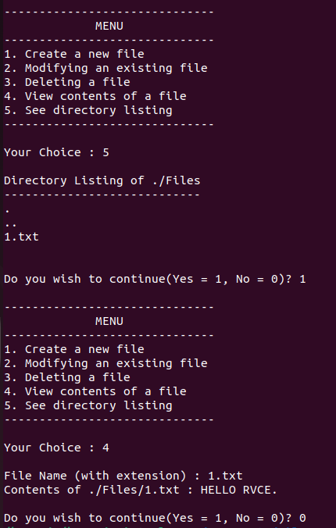
Output :

Slide 16
3. Memory Management :
It prompts the user to input the number and sizes of memory blocks.
It prompts the user to input the size of an arriving block (or process).
It allows the user to choose one of the three allocation strategies: First Fit, Best Fit, or Worst Fit.
Depending on the chosen strategy, it allocates the arriving block to an appropriate memory block based on the strategy's criteria.
Finally, it displays the result of the allocation, indicating which memory block the arriving block has been allocated to.

Slide 17
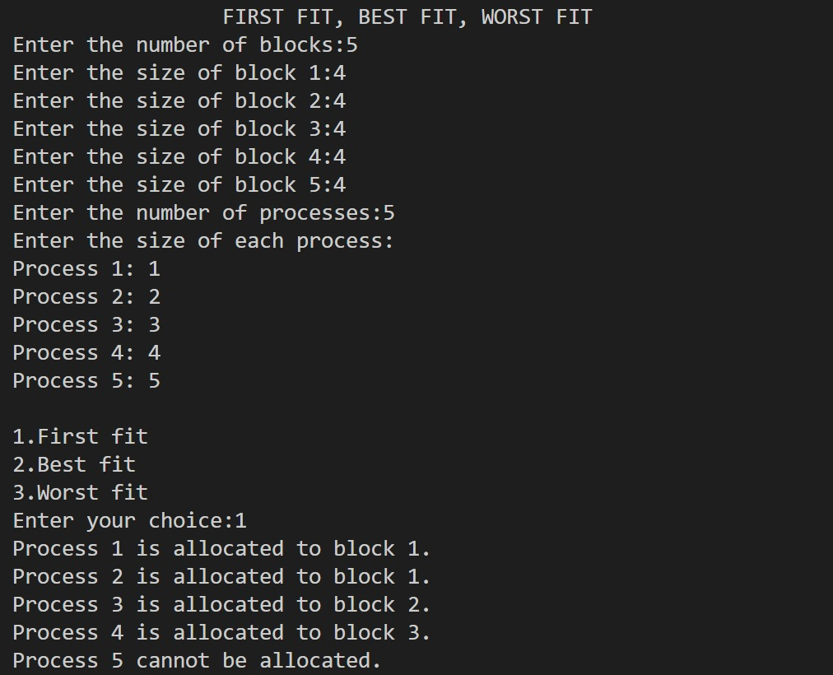
Output :

Slide 18
REFERENCES
Youtube:
Building an OS
https://www.youtube.com/playlist?list=PLFjM7v6KGMpiH2G-kT781ByCNC_0pKpPN
OS Development
https://www.youtube.com/playlist?list=PLBK_0GOKgqn3hjBdrf5zQ0g7UkQP_KLC3
Github:
https://github.com/gregkh/kernel-development
Journal Paper:
Development of a Kernel: A Deeper Look at the Architecture of an Operating System
May 2019
DOI:10.1007/978-3-030-16053-1_10
In book: Proceedings of the 4th Brazilian Technology Symposium (BTSym'18) (pp.103-114)

